Slide 1
Today
 | 2021 |  |  |  |  |  |  |  |  |  |  |  | 2024 |  |  |  | 2025
 | 35 | 36 | 37 | 38 | 39 | 40 | 41 | 42 | 43 | 44 | Nov | Dec | Q1 | Q2 | Q3 | Q4
Lane 1
Lane 2
Lane 3
Lane 4
Lane 5
Inc 23-3 | Inc 23-4 | Inc 24-1 | Inc 24-2 | Inc 24-3 | Inc 24-4

Slide 2
Today
 | 2023 |  |  |  |  |  |  |  |  |  |  |  | 2024 |  |  |  | 2025
 | Jan | Feb | Mar | Apr | Maj | Jun | Jul | Aug | Sep | Oct | Nov | Dec | Q1 | Q2 | Q3 | Q4
Lane 1
Lane 2
Lane 3
Lane 4
Lane 5
Inc 23-1 | Inc 23-2 | Inc 23-3 | Inc 23-4 | Inc 24-1 | Inc 24-2 | Inc 24-3 | Inc 24-4

Slide 3
 | Jan | Feb | Mar | Apr | May | Jun | Jul | Aug | Sept | Oct | Nov | Dec
Increments

Slide 4
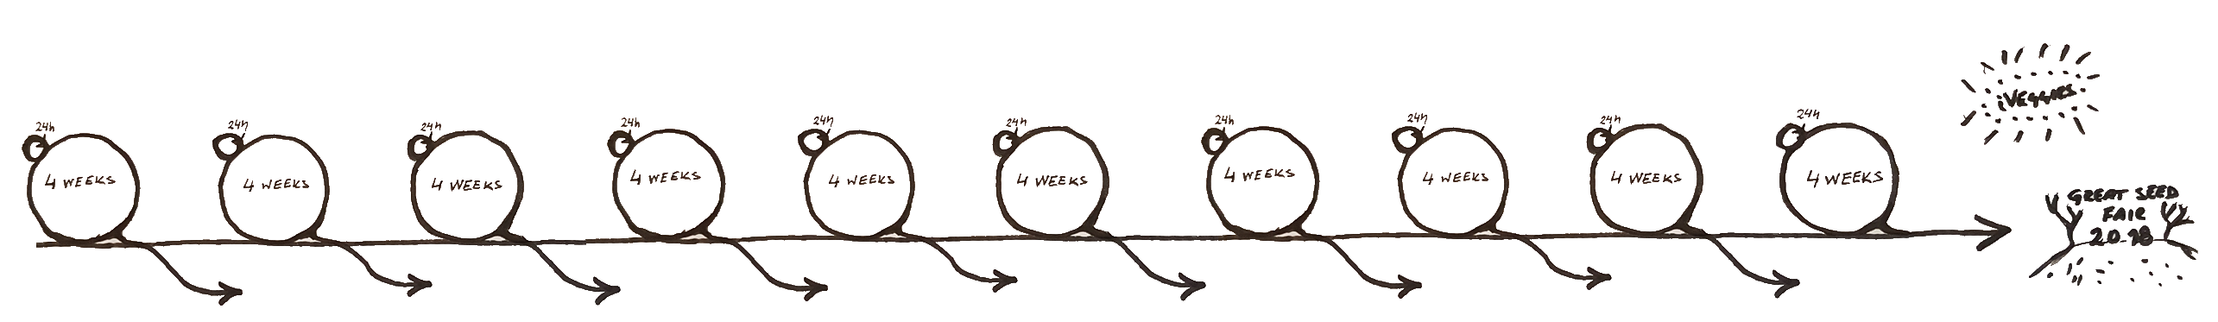



High level plan
Main Message
Often a few non-negotiable milestones (black bubbles).
It's often useful to do the plan with rows for the big external dependencies.
Don't add more details, they will change anyway!
Investor demo
Release
 | Jan | Feb | Mar | Apr | May | Jun | Jul | Aug | Sept | Oct | Nov | Dec
Sales & Marketing
Manufac-turing plant
Source & supply
External Test
Increments
Order hard-tools
Prototype manufacturing
Mass production
Find contractors
Risk order components
Order on forecast
CE certification
Environmental
tests
Pre-type approval
Environmental
tests
Type approval
Customer:
Notes:
P
-Visualisera vägen till projektmålet
-Visualisera långa aktiviteter
-Öka förståelde få externa beroenden
M
-Spendera lite tid
-Alla ska förstå
-Akta så det inte blir plandrivet, det ska vara stöd unde planning och sedan vara inaktuellt

Slide 5
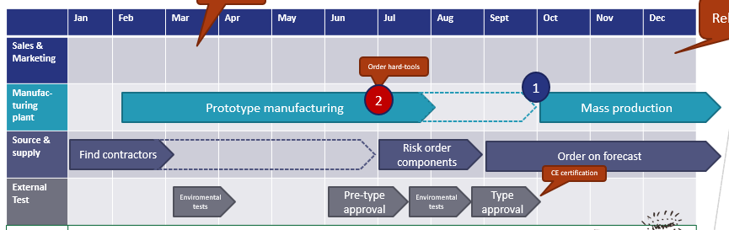
Backwards-planning
Step 2 Continue working backwards until you find the earliest point where you are free from constraints. This is eqivalent to where the the ”critical line” starts.
Step 1 Work backwards and find the latest point where you go from Complicated to Complex. This is the last responsible moment to stop adding features.
Step 3 Allow yourselves to iterate freely up until the ”last responsible moment” and lock contraints along the way as needed.
Complex development,
no constraints / commitments
Complex development,
some constraints / commitments
Complicated development
Complex manufacturing
Complicated manufacturing
Notes:
P
-Visualisera vägen till projektmålet
-Visualisera långa aktiviteter
-Öka förståelde få externa beroenden
M
-Spendera lite tid
-Alla ska förstå
-Akta så det inte blir plandrivet, det ska vara stöd unde planning och sedan vara inaktuellt

Slide 6
Graphical Elements
Release 1
Lane 1
Lane 1
 | Oct | Nov | Dec
Release 2
Lane 1
Lane 2
Release 3
Lane 1
Lane 3
Release 4
Lane 1
Lane 4
Release 4
Lane 1
Lane 5

